Slide 1
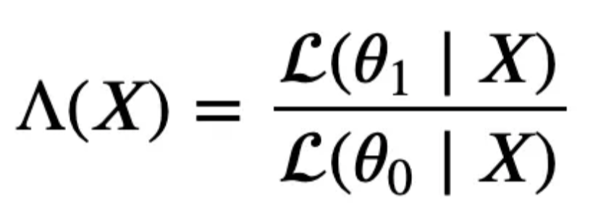
Wald sequential testing
The likelihood ratio test tries to assess the likelihood that the observed data was generated by either one of two competing statistical models.
Likelihood ratio:
Decision rule as follows:
If Λ>b, reject H₀;
If Λ<a, do not reject H₀,
where a and b are boundaries

Slide 2
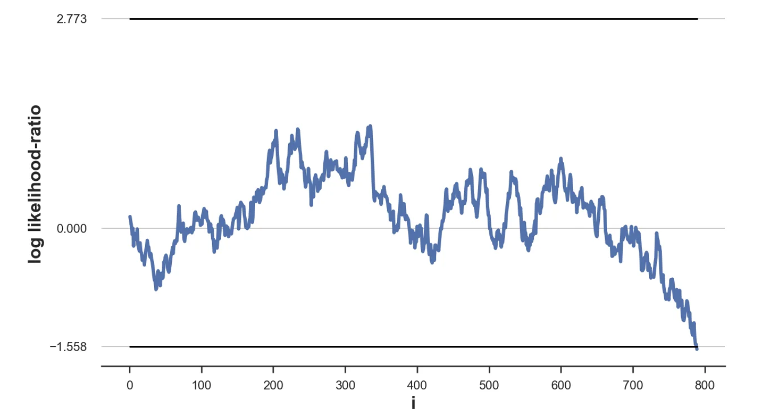
Sequential test example

Slide 3
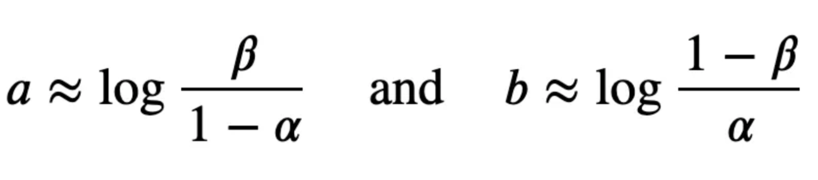
Boundaries calculation
Wald shows that the choice of the following boundaries delivers a test with an expected probability of type 1 and 2 errors not greater than α and β.

Slide 4
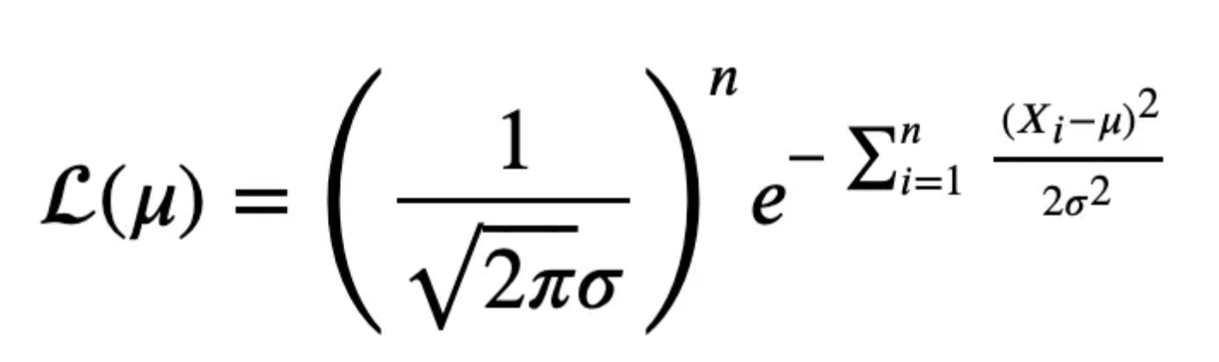
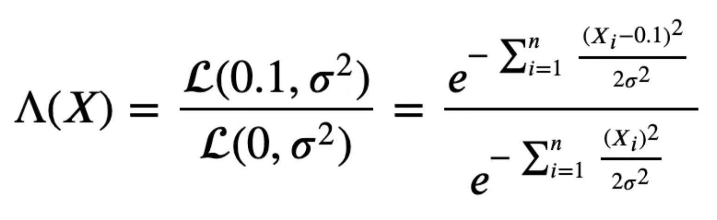
What about the thetas
The likelihood of a normal distribution with unknown mean μ and known variance σ² is:
So the likelihood ratio under the two hypotheses is:

Slide 5
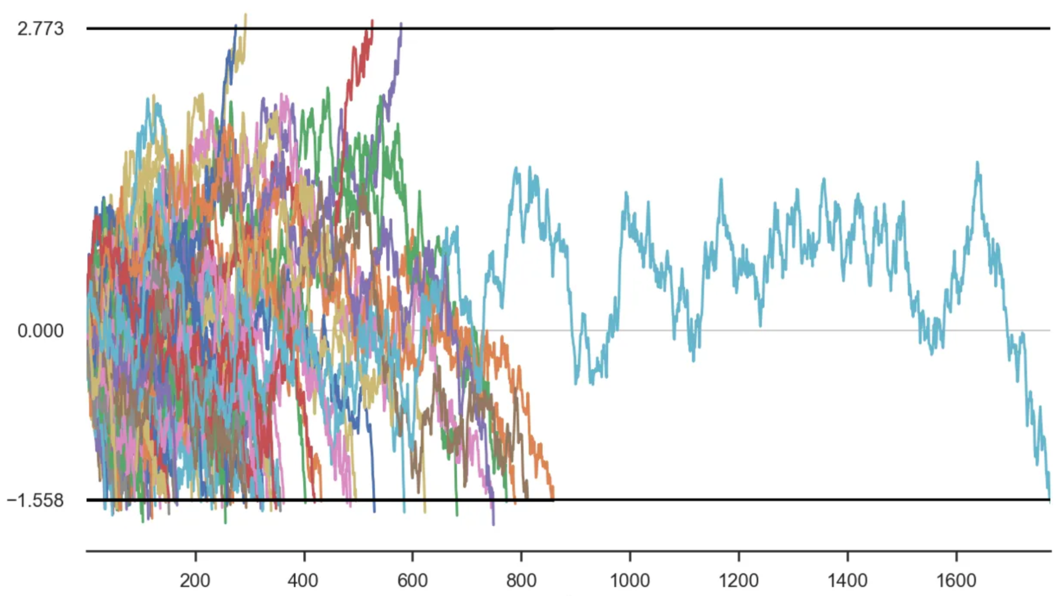
There is a probability sequential test will last longer than z test

Slide 6
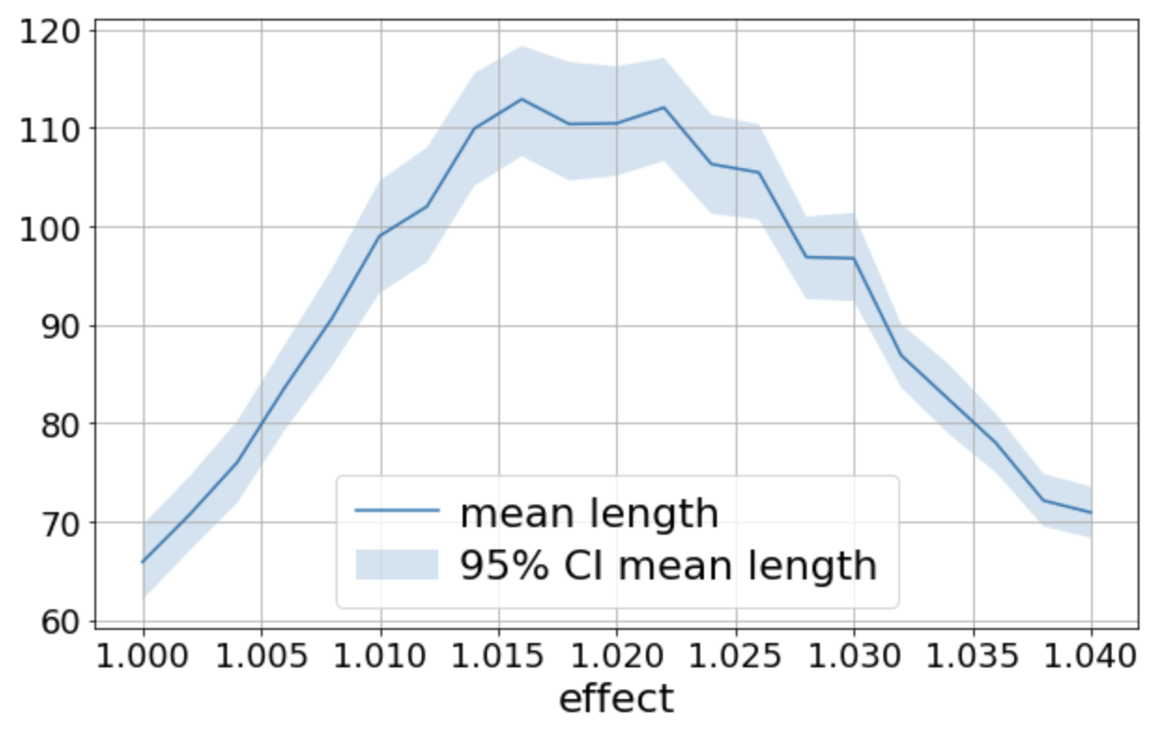
Sample size change depending on real effect
MDE=3%

Slide 7
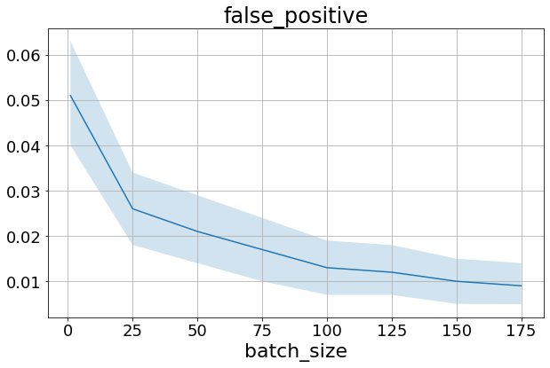
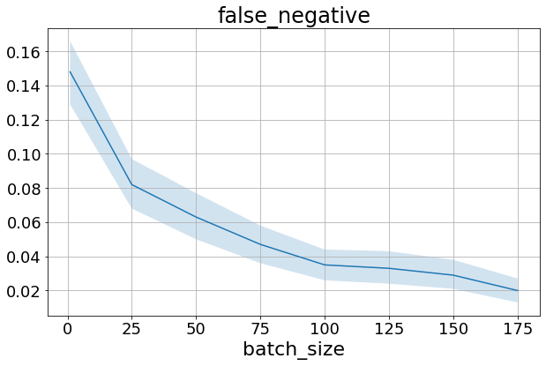
Error rate change depending on batch size

Slide 8
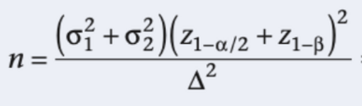
Other techniques
Stratification
CUPED (CUPAC)
mSPRT
MAB

